Slide 1
Disclaimer: I am learning how to do this for the first time.

Slide 2
Phylogeny

Slide 3
Sessa et al. 2014

Slide 4
Transposon = transposable element (same thing)
DNA/DNA
(DNA transposons)
DNA/RNA/DNA
(RNA transposons, retrotransposons)
2 kinds!
they copy!

Slide 5
DNA/DNA
DNA/RNA/DNA
https://www.nature.com/scitable/topicpage/transposons-the-jumping-genes-518

Slide 6
Can you make phylogenies of
multiple copies of
related transposable elements?

Slide 7
Hmmm, maybe we should read the
first paragraph in the
birth-death models section on
page 78

Slide 8
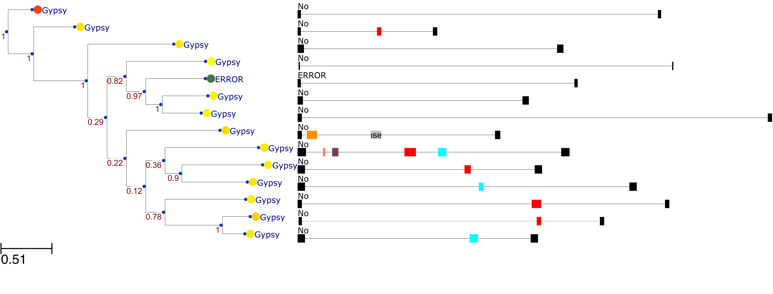
Here is a phylogeny of 14 long terminal repeat (LTR) DNA/RNA/DNA transposable elements (retrotransposons)

Slide 9
Ultrametric tree
The corresponding LTT plot

Slide 10
Log2 LTT plot
LTT plot

Slide 11
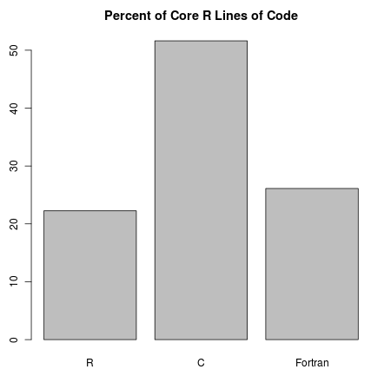
A computer programming language:
A language intended to express the kinds of
things you can make a computer to do
http://blog.revolutionanalytics.com/2011/08/what-language-is-r-written-in.html

Slide 12
You type words and symbols which get interpreted by R as process to be carried out by the computer
Like:
print(4+1)
It’s pretty easy to guess what that one does
In R and a lot of other computer programming languages, some words are special and have parentheses after them, like print
If you see that then you know print is a function. That’s because a lot of the time you give functions input between the parentheses, like some numbers, or maybe some letters, or a table.
Most words and other combinations of letters and numbers are not reserved for functions so you can even make your own functions and name them what you like.
You can make words and other combinations of letters and numbers refer to things other than functions, too.
Like:
four_plus_one <- 4 + 1
And then this does the same thing as above:
print(four_plus_one)

